Slide 1
Normal Accidents
Unnatural Disasters
Seminar

Slide 2
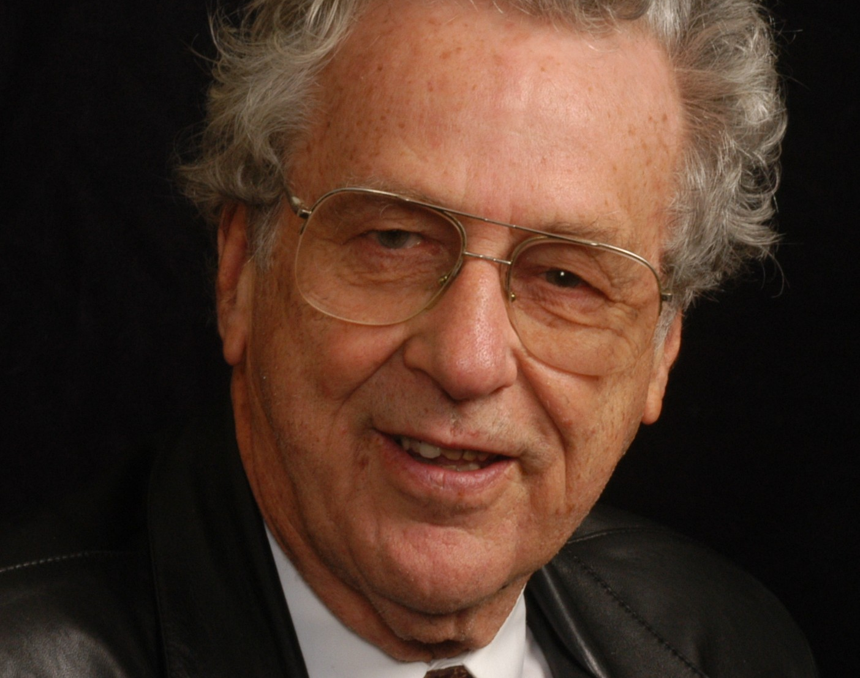
Charles Perrow
Normal Accidents: Living with High-Risk Technologies
A sociological approach to technological risk, accidents and catastrophe

Slide 3
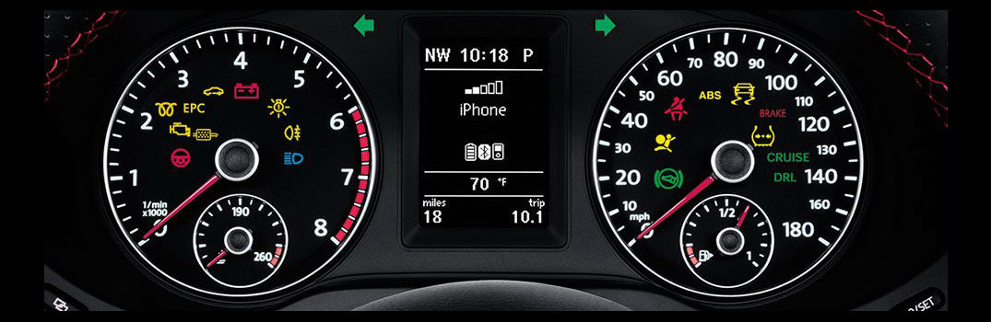
A day in my life

Slide 4
Accidents are normal
“No matter how effective conventional safety devices are, there is a form of accident that is inevitable” (3).

Slide 5
Define ’normal accident’ and identify one example.
Notes:
unintended and untoward event, causes harm, and disrupts ongoing or future ‘tasks’

Slide 6
Three Mile Island

Slide 7
President’s commission on 3 Mile Island
Who was blamed?

Slide 8
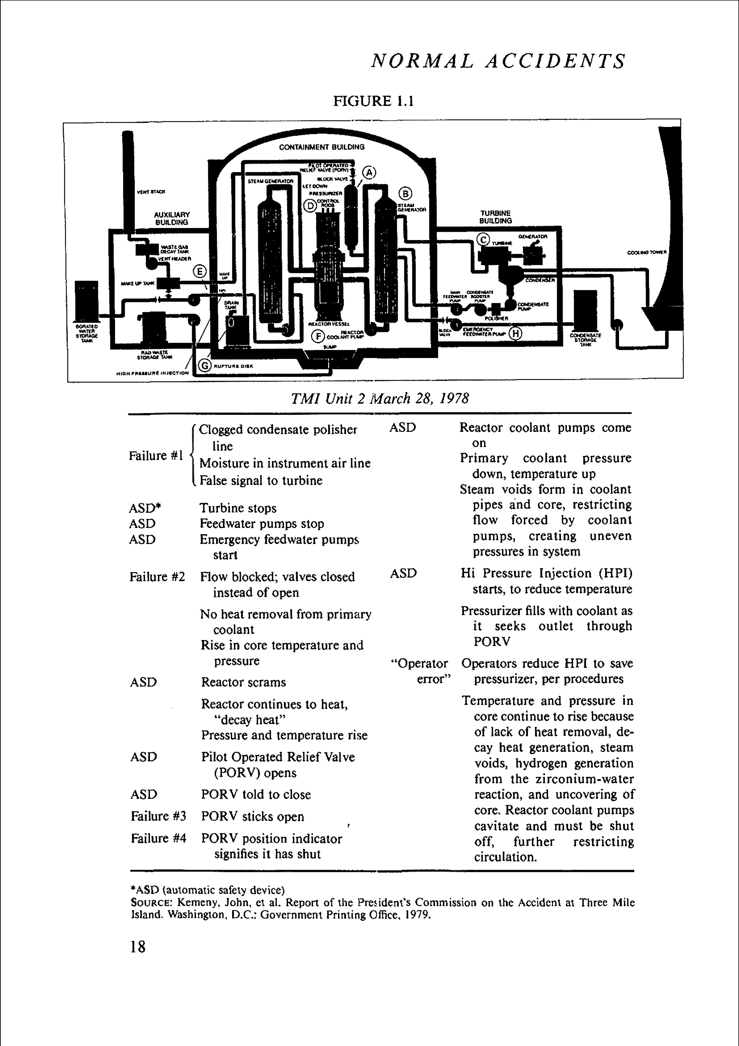

Slide 9
Why was Three Mile Island a ‘normal accident’?
And who should be blamed if it is?

Slide 11
“Seeing is not believing”
“In complex industrial, space, and military systems, the normal accident generally (not always) means that the interactions are not only unexpected, but are incomprehensible for some critical period of time.”
We must believe before we can see (ie culture/society before perception)

Slide 12
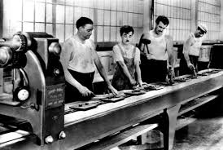
Sociological Concept: Systems Systems are both social and technical
Organizational sociology
The field began with efforts to improve reliability and productivity of work systems
E.g. Taylor’s studies of the factory

Slide 13
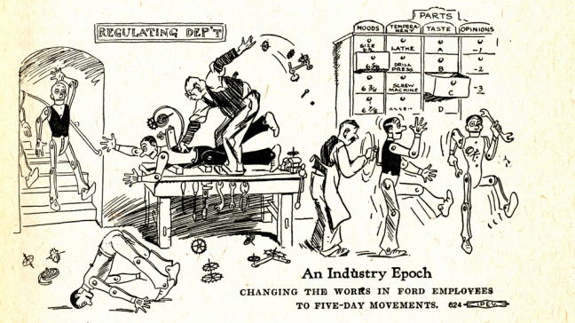

Slide 14
Organizations as systems
Organization-environment relations
Systems exhibit common elements and processes across scales and types: from biological cells to solar systems
For example, we can speak of ‘negative feedback loops’ when analyzing the human heart, the design of an air conditioning system, or democratic electoral politics

Slide 15
The 3 Cs: Perrow’s key concepts

Slide 16
1. Complexity

Slide 18
Safety devices increase complexity!

Slide 19
2. Coupling

Slide 20
3. Catastrophe

Slide 21
Not one chance in a million, but one chance in a decade
Notes:
system accidents are uncommon, even rare; yet this is not all that reassuring, if they can produce catastrophes.

Slide 22
1984

Slide 23
1985

Slide 24
1986

Slide 25
Chernobyl: 26 April 1986

Slide 26
Chernobyl discussion
Was this a normal accident?

Slide 27
Discussion/Debate
Are there technologies which, even though we can develop them, we shouldn’t use them?
How would we determine if this is the case?

